Slide 1
Real-time Ocean Wave Rendering
Diane Marinkas
CDA 6938
April 30, 2009

Slide 2
Outline
Motivation
Algorithm
CPU Implementation
GPU Implementation
Performance
Lessons Learned
Future Work

Slide 3
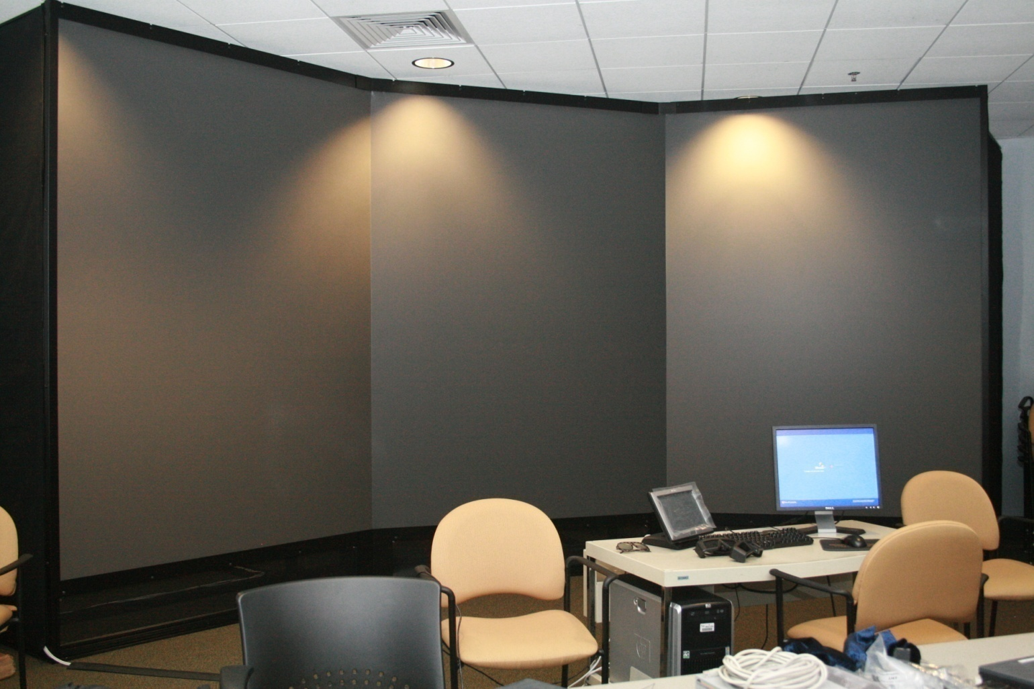
Motivation
Real-time, interactive demo for “Big Baby”
With head-tracking and stereo vision

Slide 4
Big Baby
6 projectors, 2 per screen
4 Nvidia Quadro FX 5600
1 per screen, 1 for server
1.5GB GDDR3
76.8 GB/s bandwidth

Slide 5
Algorithm – (Very) Brief Overview
Goal: A statistical model for wave movement
Compute h₀
Complex Fourier domain amplitudes of wave height field
Compute Phillips spectrum (semi-empirical model from oceanography)
Compute ħ
Fourier domain amplitudes at time t
Bring into spatial domain with IFFT (complex to real)
Sum of sine and cosine waves

Slide 6
Details
Final values go into 1d buffer of complex numbers; waves propagate in both directions
(1)
(2)
Independent draw from Gaussian random number generator
(3)
w is wind direction, k is wave vector
(4)
Dispersion relationship
Take IFFT of buffer (1)

Slide 7
CPU Implementation
Use FFTW library
Optimized for modern CPUs (SSE/SSE2)
Some packed vector operations
Multi-threading
Even support for cell processor

Slide 8
GPU Implementation
Faster computation and better frame rate than CPU
Advantage: free up CPU to do other things (i.e., game logic, physics, etc.)
CUFFT library that ships with CUDA
Based on FFTW
Fourier grid even up to 2048 x 2048
More detailed
Above 2048 limits of numerical accuracy for floating point calculations become noticeable (and slow!)

Slide 9
Video

Slide 10
Performance
Fourier Grid Size | CPU fps | GPU fps | CPU time (ms) | GPU time (ms) | Speedup
256 x 256 | 30 | 60 | 39.6 | 13.9 | 2.8
512 x 512 | 8 | 45 | 152.7 | 34.1 | 4.48
1024 x 1024 | 2 | 16 | 520.3 | 112 | 4.65
2048 x 2048 | 0.5 | 4 | 2046.7 | 520.28 | 3.93
System specs:
AMD Athlon64 X2 Dual Core 4000+ 2.11GHz
4 GB RAM
Nvidia 9800 GT

Slide 11
Time (ms)

Slide 12
Lessons Learned
Some things are just easier and/or faster to do on CPU
Height field generation requires RNG
Unavailable on gpu
Could use parallel Mersenne Twister (one RNG runs on each processor)
Precomputing random numbers and sending to gpu kernel hurt performance
Memory transfer
Some aspects are CPU-bound
i.e. Limited by graphics API

Slide 13
Future Work
Water below the surface
Caustics
Realistic rendering
Radiosity of ocean environment
Realistic lighting
Head-tracking

Slide 14
References
[1] Tessendorf, Jerry. 2004. "Simulating Ocean Water." In SIGGRAPH 2004 Course Notes.
[2] Mitchell, Jason L. Real-time Synthesis and Rendering of Ocean Water. ATI Research Technical Report, 2005;

