Slide 1
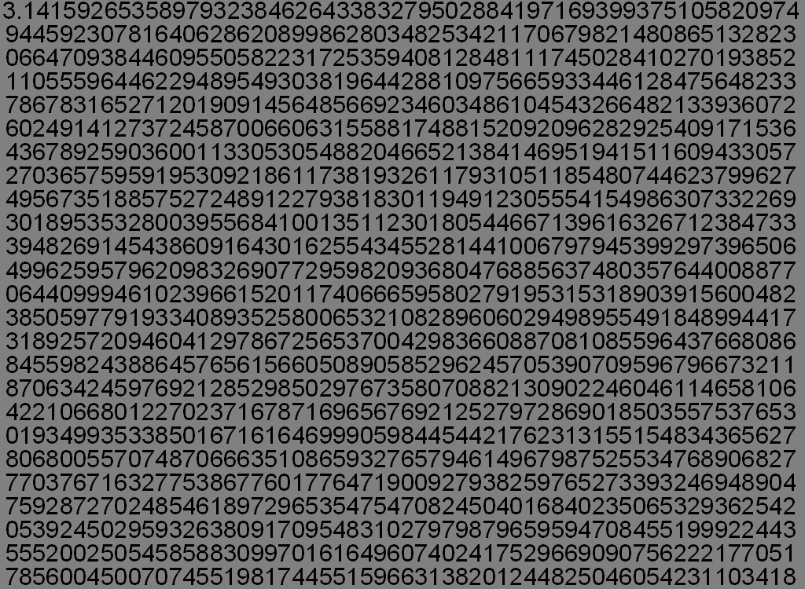
Chinese Arithmetic on Many-core Processors
Jonathan Mee’s CDA6938 Semester Project

Slide 2
Motivation
Highly Precise Calculations
Excellent Many-core Speedup
Integers Not Real Numbers
Virtually Unlimited Integer Size without Loss of Accuracy

Slide 3
Chinese Arithmetic
Static Set of Modulo Keys
Keys Must Be Relatively Prime
Local Set of Corresponding Mods
Additions, Subtractions, and Multiplications Performed on Local Sets
Divisions Not Supported
Negative Numbers Not Supported by My Algorithm

Slide 4
Example
Key | 7 | 12 | 13
10 | 3 | 10 | 10
41 | 6 | 5 | 2
5 | 5 | 5 | 5
Key | 7 | 12 | 13
5*41=205 | 30%7=2 | 25%12=1 | 10%13=10
5+10=15 | 8%7=1 | 15%12=3 | 15%13=2
205-15=190 | 1%7=1 | -2%12=10 | 8%13=8
7 | 8 | 15 | 22 | 29 | 36 | 43 | 50 | 57 | 64 | 71 | 78 | 85 | 92 | 99 | 106 | 113 | 120 | 127 | 134 | 141 | 148 | 155 | 162 | 169 | 176 | 183 | 190
12 | 10 | 22 | 34 | 46 | 58 | 70 | 82 | 94 | 106 | 118 | 130 | 142 | 154 | 166 | 178 | 190
13 | 8 | 21 | 34 | 47 | 60 | 73 | 86 | 99 | 112 | 125 | 138 | 151 | 164 | 177 | 190

Slide 5
Algorithm Sections
Generate
Distribute
Mod
Mod
Mod
Arithmetic
Arithmetic
Arithmetic
Collect
Collect
Collect
Verify

Slide 6
Generate
Numbers Generated Randomly
Addition, Subtraction, Multiplication, and Division Operations Ordered Randomly
Clearly Done on CPU

Slide 7
Distribute
Cell | GPU
Fast Transfers Easier to Mail Numbers | Easy Prime Distribution
Unequal Starts | Difficult Number Distribution Slow DMAs

Slide 8
Mod
Distributed | On CPU
Less Data Transfer Needed Parallel Should be Faster | Cheaper Operations
VERY Expensive Unequal Starts | Significant Memory Required Significant Transfer Required All Cores Wait Upon the CPU

Slide 9
Arithmetic
Cell | GPU
 | Huge Number of Mods
Only 4 Elements at a Time Expensive Multiplication | Annoying Mod Step

Slide 10
Collect
Distributed | On CPU
Less Data Transfer Needed Parallel Should be Faster | Cheaper Operations
VERY Expensive Implausible on GPU Unequal Ends | Significant Memory Required Significant Transfer Required All Cores Wait Upon the CPU

Slide 11
Verify
Distributed | On CPU
Able to Have Data Ready Parallel Should be Faster | Cheaper Operations
Implausible on GPU Unequal Ends | Operations vs. Verification

Slide 12
Results

Slide 13
Works Cited
Dewdney, A. K. The (New) Turing Omnibus. New York: Owl Books, 1993.
Knuth, Donald E. The Art of Computer Programming. Ed. Michael A. Harrison. 2nd ed. 2 vols. Reading: Addison-Wesley Publishing Company, 1969.

